Slide 1
Image Steganography in Spatial Domain A Comparative Literature Review of SCI Articles
Musawer Muradi 195112046
29.11.2020
Class Id: BTM551 Supervisor: Asst. Prof. SERDAR SOLAK
Department of Computer Engineering
Kocaeli University, 41380, Kocaeli
musavir.muradi@gmail.com

Slide 2
Contents
Contents
Introduction
Methodology (Methods, Materials, Validation Metrics)
Analysis
Results
References

Slide 3
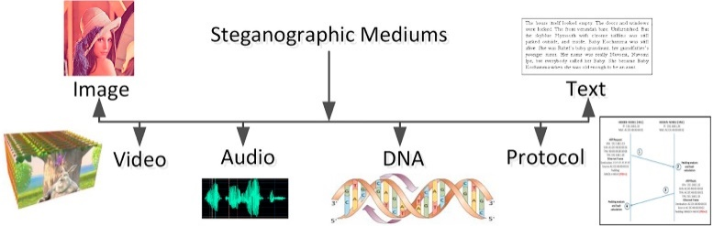
Introduction
Steganography is a secret communication technique when the messages between to edge are encrypted and no one can detect the existence of hidden messages except the sender and the receiver of the message.
Stegano: covered – Graphos: write
Spatial and Transform Domains
Spatial domain directly exploits the cover image data/pixels to conceal the secret information

Slide 4
Methodology
The search focused on SCI articles published in 2020 on domains such as IEEE, Scopus, Elsevier, ResearchGate, ScienceDirect, Google Scholar, arXiv, etc.
The search strings were: spatial domain image steganography · image steganography · least significant bits (lsb) · pixel value differencing (pvd) · data hiding techniques.
At least 20-30 articles published by the mentioned domains examined and the most relative 3 selected. The value and motivation of each paper summarized and then gone over each for reviewing

Slide 5
Materials(Articles)
A Secure Image Steganography using LSB and Double XOR Operations published IJCSNS International Journal of Computer Science and Network Security in July 2020.
The Steganographic Approach to Data Protection Using Arnold Algorithm and the Pixel-Value Differencing Method published in IEEE Third International Conference on Data Stream Mining & Processing in 2020.
LSB and RLE Based Approach for Increasing Payload and Security of Stego Images published in Advances in Intelligent Systems and Computing in 2020.

Slide 6

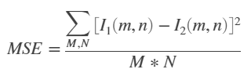
Validation Metrics
The mean-square error (MSE) and the peak signal-to-noise ratio (PSNR) are used to compare image compression quality.
PSNR
MSE

Slide 7
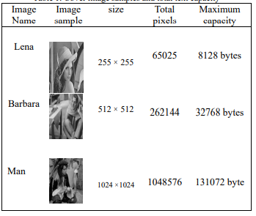
Analysis: Secure Image Steganography using LSB and Double XOR Operations
1st step: The message is encrypted by using a Secret key (extract from MSB) and double XOR operations
2nd step: The result is embedded into the cover image using lsb.
3rd step: The extraction process begin with decoding of the stego image.
4th step: The extracted message which is still in encrypted mode is reverted back to normal state using double XOR operations.

Slide 8
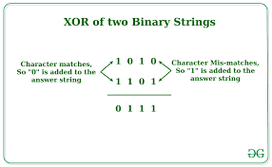
Analysis: Secure Image Steganography using LSB and Double XOR Operations

Slide 9
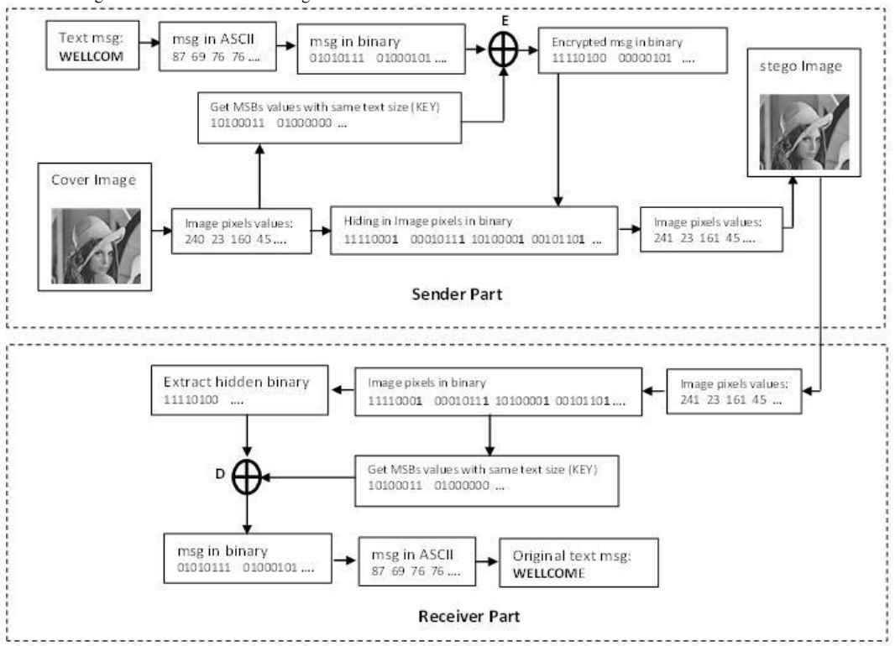
Analysis: Secure Image Steganography using LSB and Double XOR Operations

Slide 10
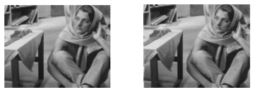
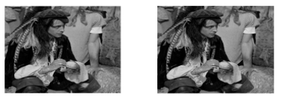
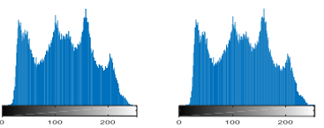
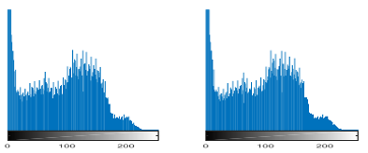
Analysis: Secure Image Steganography using LSB and Double XOR Operations
Cover image Stego image
Cover image Stego image
Histogram for Cover/Stego images
Histogram for Cover/Stego images

Slide 11
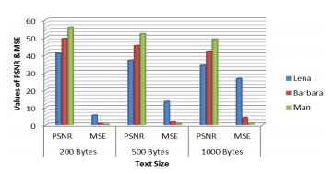
Analysis: Secure Image Steganography using LSB and Double XOR Operations
The PSNR values for the algorithm used in this article is always above 40 dB, which is acceptable performance according to he authors.

Slide 12
Analysis: The Steganographic Approach to Data Protection Using Arnold Algorithm and the Pixel-Value Differencing Method
Hide data in spatial domain of BMP files which is simple in structure and large in volume.
The authors implement the steganographic transformations by the pixel difference method (Pixel-Value Differencing – PVD) enhanced by the Arnold Algorithm.
Uses the classic PVD techniques, but not on raw images.

Slide 13
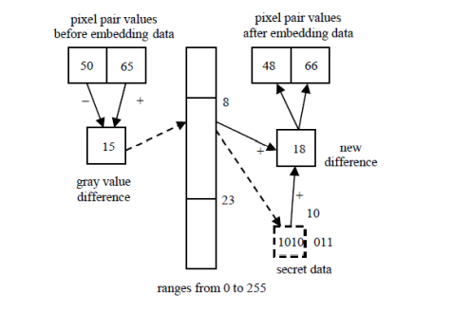
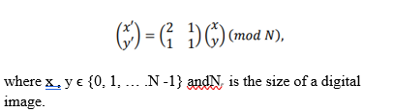
Analysis: The Steganographic Approach to Data Protection Using Arnold Algorithm and the Pixel-Value Differencing Method
Pixel Value Differencing
Arnold Algorithm
Arnold algorithm is an powerful and simple scrambling algorithm widely used in spatial domain.

Slide 14
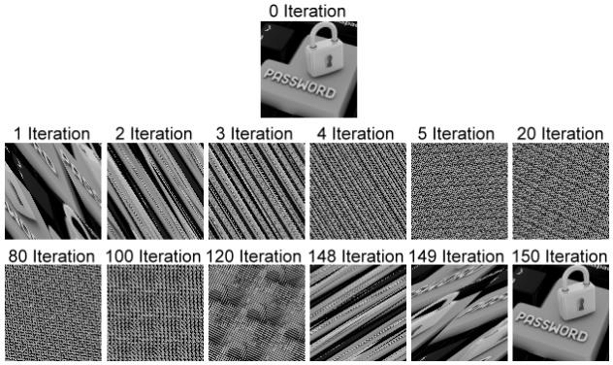
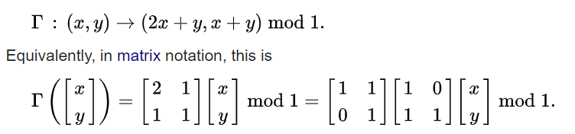
Analysis: The Steganographic Approach to Data Protection Using Arnold Algorithm and the Pixel-Value Differencing Method

Slide 15
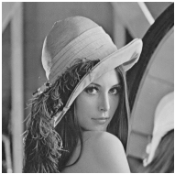
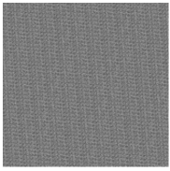
Analysis: The Steganographic Approach to Data Protection Using Arnold Algorithm and the Pixel-Value Differencing Method
1st step: Scramble the images using the Arnold transformation.
2nd step: Stop the converting image process by Arnold transformation at the some step for order to hide the message in the resulting modified image. The Arnold transformation series stop number during decoding process uses as the secret key.
3rd step: PVD is applied as it should be and for decrypting the inverse of the same operation is conducted.

Slide 16
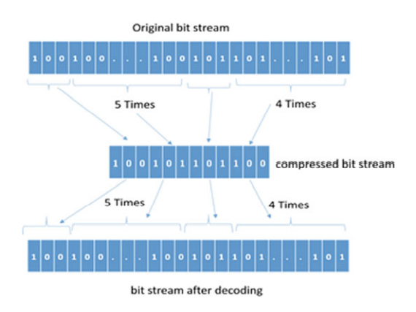
Analysis: LSB and RLE Based Approach for Increasing Payload and Security of Stego Images
This method achieves security and increased payload.
The work is essentially a blend of LSB and run-length encoding (RLE) techniques
RLE is lossless image compression technique.

Slide 17
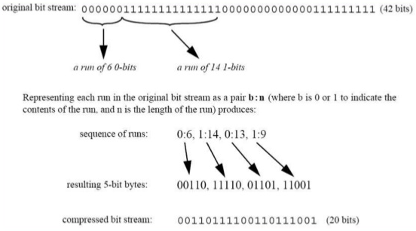
Analysis: LSB and RLE Based Approach for Increasing Payload and Security of Stego Images

Slide 18
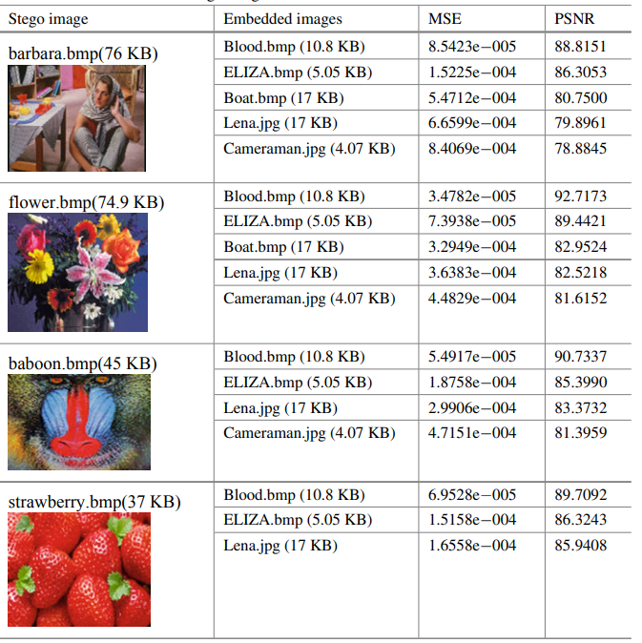


Analysis: LSB and RLE Based Approach for Increasing Payload and Security of Stego Images
The message images:

Slide 19
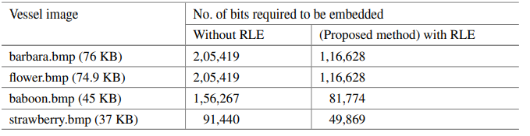
The bits required to embed the aforementioned message images are reduced by 50% after implementing the RLE.

Slide 20
Result
In this paper, three SCI articles are reviewed comparatively, the methods and steganography techniques compared:
In LSB/XOR implementation, the security of the hidden message enhanced, but the PSNR value is merely above 40 dB.
The most secure technique of the forementioned methods is PVD/Arnold Algorithm.
Less secure comparing to the techniques used in reviewed papers. But has the less deterioration rate. The PSNR is above 80 dBs.

Slide 21
Thanks
Please refer to the Image Steganography in Spatial Domain: A Comparative Literature Review of SCI Articles for References.

